Slide 1
Problems and Users
sdmay25-29

Slide 2
Project Overview
Implement the Atanasoff-Berry Computer using modern components
The Atanasoff-Berry Computer (ABC) was the first electronic digital computer.
The purpose of the ABC computer was to solve systems of linear equations.
The ABC computer was constructed here at Iowa State.
The original ABC was destroyed in 1948.
We are recreating it as an educational demonstration of how it functioned.
The device that we make will be used as a learning aid to help teach students how computers function.

Slide 3
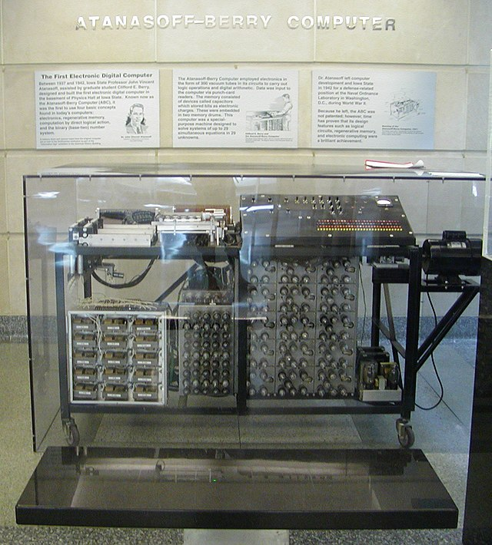
Problem Statement
Computer engineering professors need a good way to visually teach their students about the logic of a computer. Using a simple computer design (the ABC) will help students better understand the full functionality of the computer. We must perform in-depth research before we can prototype, and build our machine.

Slide 4
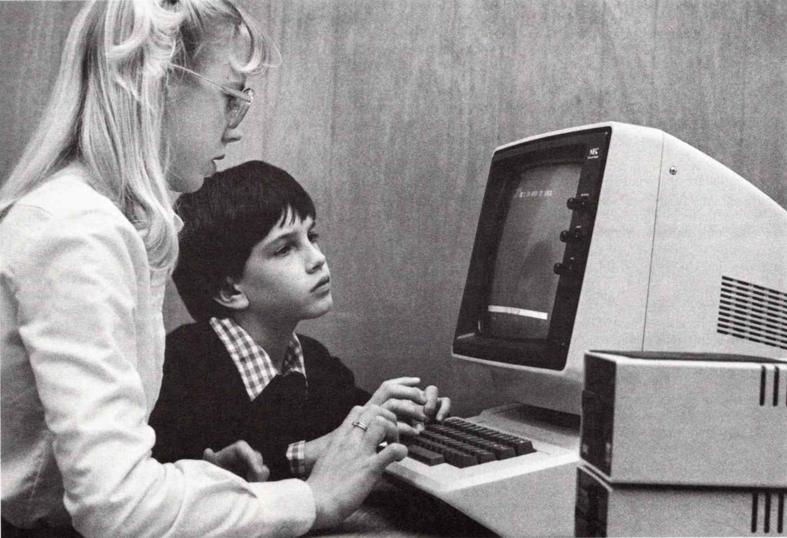
Personas
Computer Engineering Professor
Teaches students about digital logic
Uses the ABC recreation as a teaching aid
Computer Engineering Student
Learning about digital logic
Uses the ABC recreation to help learn about computer system components.
Uses the ABC recreation to help understand what is happening on the inside of computers.
Computer Engineering Enthusiast
Thinks the ABC computer is a cool piece of history
Would like to reuse our design to build the ABC recreation themselves

Slide 5
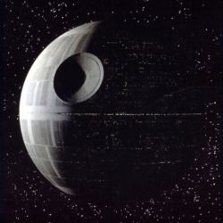
User Needs
Functional
Must be a recreational design
Use the same logic as the ABC , with modernization
Physical
Must be a tangible physical object
Aesthetic
Should visualize the steps of calculations that machine is going thru
Must look cool!
User Experience
Gives the machine input
Watch machine perform calculations
Receive correct solutions from input

Slide 6
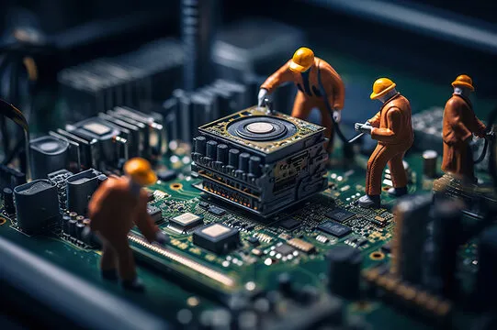
Conclusion
Overall, we have determined the problem we are solving with our project and who our users will be. We hope this project will see much use in academics at Iowa State. We will continue to develop our design and consider who are users may be as the project progresses.
Notes:
definitely an AI image

